Slide 1

Introduction to Remote Sensing
Peter Galante
Biodiversity Informatics Scientist
Center for Biodiversity and Conservation
American Museum of Natural History

Slide 2
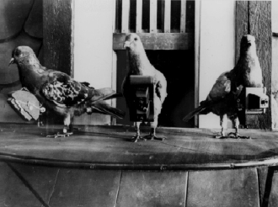
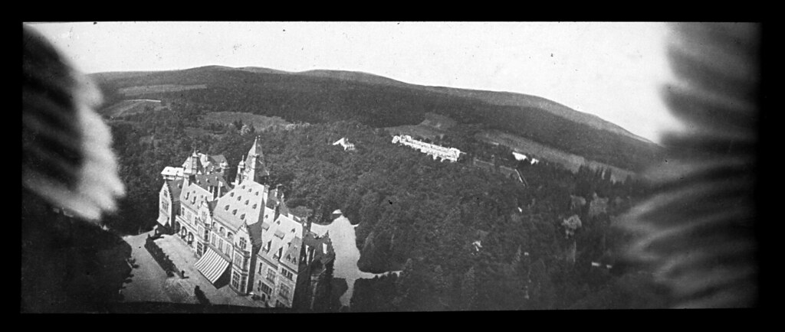
What is remote sensing?
‘Remote sensing is the science of making inferences about objects from measurements, made at a distance, without coming in contact with the objects under study’ (Joseph, 2005)
Besides balloons and kites, pigeons were used to carry cameras and could be trained to fly over targets
German scientist
Dr. Julius Neubronner

Slide 3
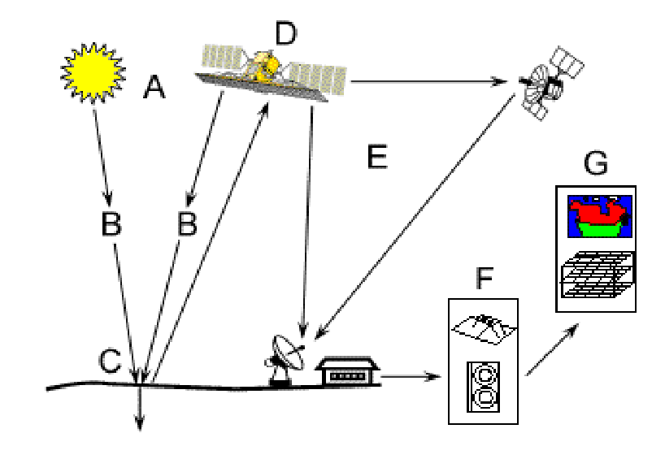
Components of remote sensing
Energy source or illumination (A)
Radiation and the atmosphere (B)
Interaction with the target (C)
Energy recording by sensor (D)
Transmission, receiving, processing (E)
Interpretation and analysis (F)
Application (G)
Credit:
De Sherbinin
et al. (2002)

Slide 4
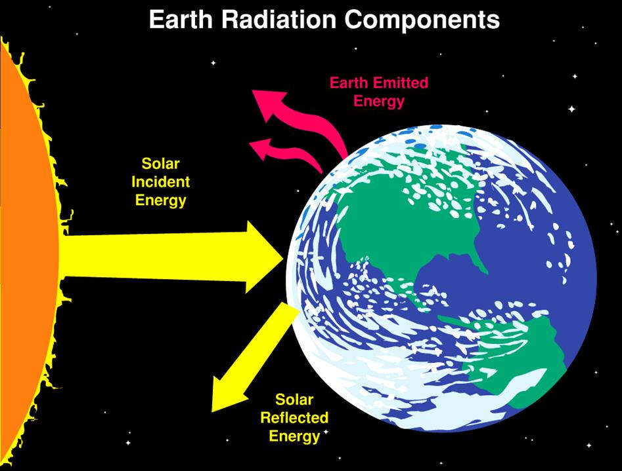
Energy source
Long-wave radiation
Short-wave radiation
Credit: NASA Applied Sciences

Slide 5
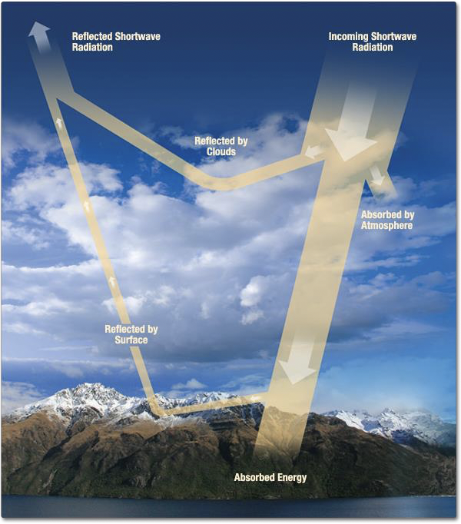
Radiation and the atmosphere
Credit:
NASA Applied
Sciences

Slide 6
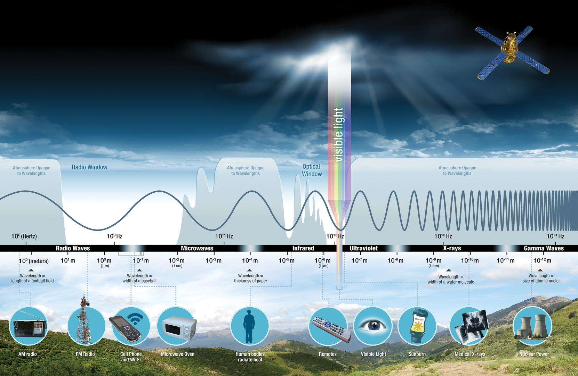
Electromagnetic spectrum
c = λ * f, where
c is the speed of light (~300,000,000 m/s)
λ is the wavelength (m)
f is the frequency (Hz)
Notes:
Electromagnetic spectrum is the range of frequencies of electromagnetic radiation and their respective wavelengths
c = λ f, where
C is the speed of light (~300,000,000 m/s)
Λ is the wavelength (meters)
F is the frequency (cycles per second or Hz)
Visible light: 0.4 – 0.7 micrometers
1x10^-6m (400 – 700 nanometers, 10^-9m)
Red: ~400 nm (0.0000004)
Green: ~500nm
Blue: ~600 nm
Violet: 700nm range

Slide 7
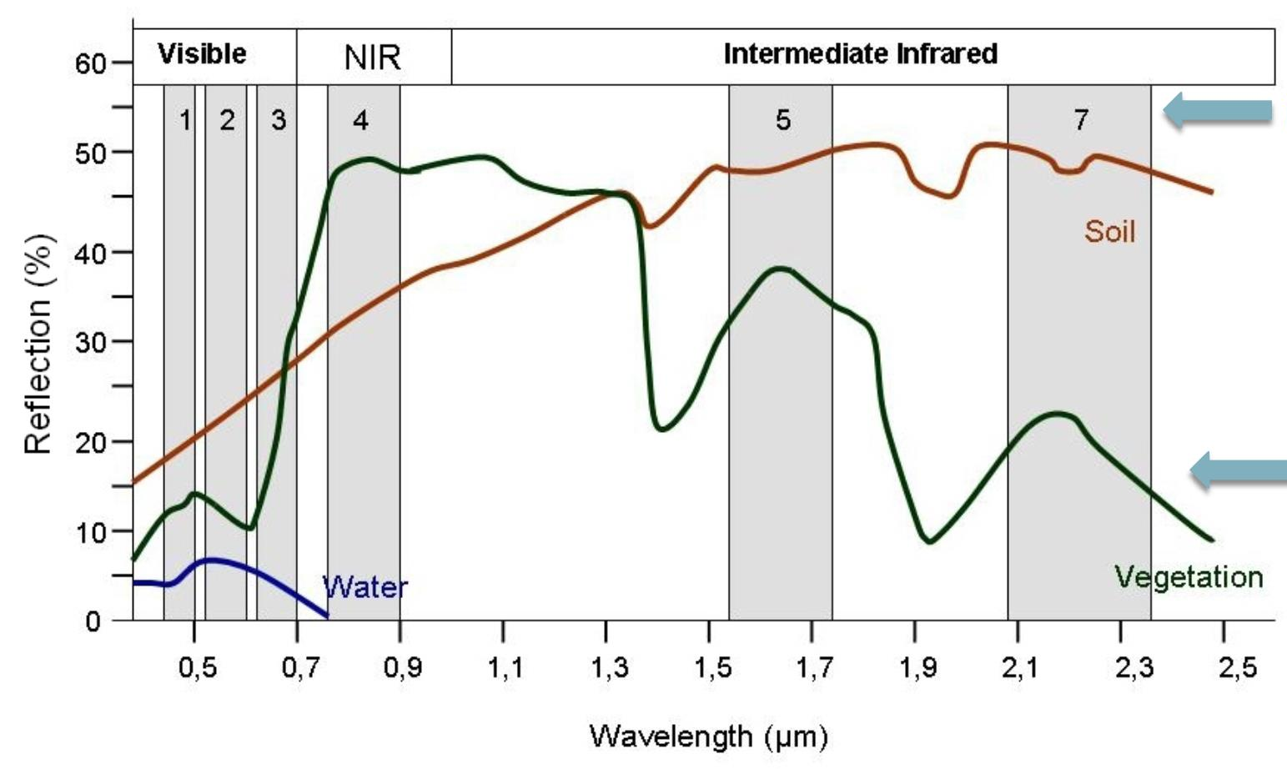
Wavelength interaction with target
Spectral Signatures
Landsat
bands
Spectral
signatures
Credit: NASA Applied Sciences

Slide 8
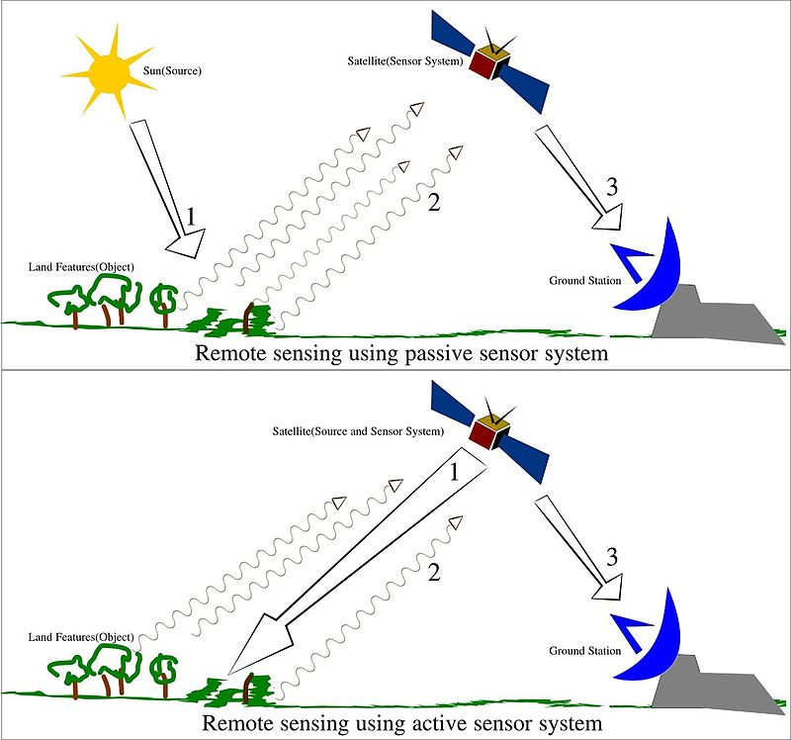
Sensor recording
Passive sensor
Active sensor

Slide 9
NASA Satellite Constellation
Notes:
Terra Satellite: Land composition, Reflected energy, Vegetation and snow, aerosols, carbon monoxide
Landsat 8: Visible, red, NIR, short-wave IR, panchromatic (combinations of bands), Cirrus (clouds)
RapidSCAT: Measures ocean wind-speed and direction
Aqua: Measures earth’s water cycle

Slide 10
ESA Sentinel Missions
Notes:
Sentinel 1: actually 2 satellites that perform Radar imaging
Sentinel 2: 2 satellites; land monitoring – vegetation, soil, coastal areas
Sentinel 3: 3 satellites; Marine observations – SST, ocean and land color
Sentinel 4: Air quality monitoring – high resolution composition of earth’s atmosphere over Europe
Sentinel 5: Air quality monitoring - composition of earth’s atmosphere globally

Slide 11
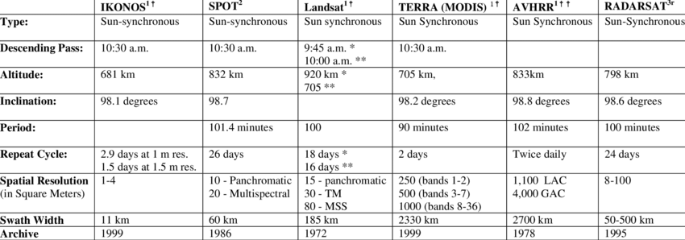
Satellite systems
De Sherbinin
et al. (2002)
Notes:
Sun-synchronous are useful for weather and spy-satellites because shadows are the same

Slide 12
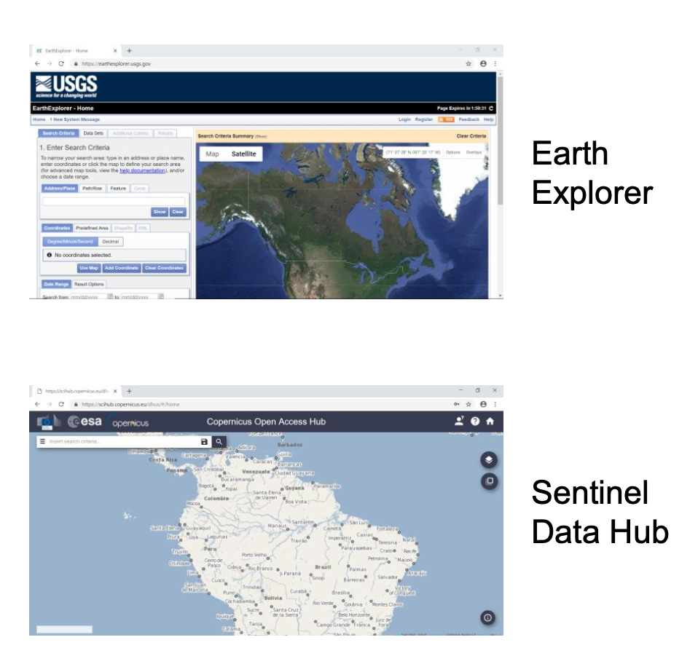
Satellite imagery
Data Portals
• NASA EarthData Search – Landsat, VIIRS, MODIS, etc.
https://search.earthdata.nasa.gov/search
• USGS / NASA AρρEEARS – Land Processes Distributed Active Archive Center (LP DAAC). https://lpdaac.usgs.gov/tools/appeears/
• ESA Sentinel Hub – Sentinel-1, 2, 3 and 5P https://scihub.copernicus.eu/
• University of Maryland – Global Forest Change data (produced by Hansen et al. 2013)
https://earthenginepartners.appspot.com/scien ce-2013-global-forest/download_v1.2.html

Slide 13
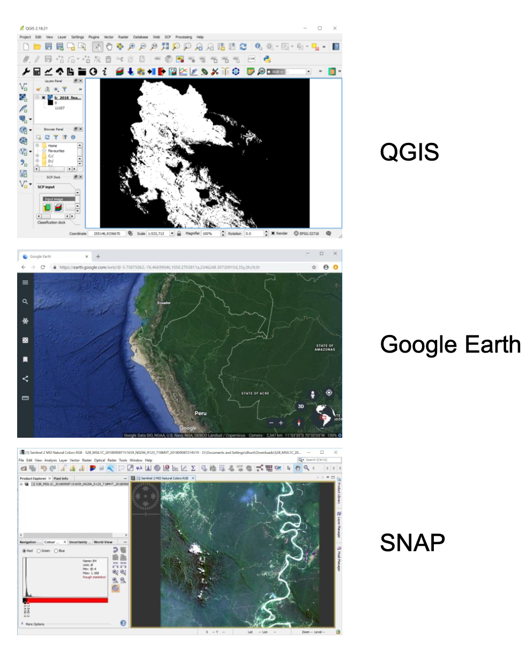
Satellite Imagery
Open Source Software & Resources
QGIS – https://qgis.org/en/site/forusers/download.html
Remote Sensing Image Analysis with R – https://rspatial.org/raster/rs/1-introduction.html\
Google Earth – visualizations – https://earth.google.com/web/
SNAP – for ESA data and radar – http://step.esa.int/main/toolboxes/snap/
Landsat explorer app – http://landsatexplorer.esri.com/
Advanced ARSET training – https://arset.gsfc.nasa.gov/

Slide 14
Remote Sensing Applications
Land cover / land use change
Population mapping
Air quality
Aquatic ecosystems
Hydrology
Weather and climate
Disaster monitoring and response
(Many more…)

Slide 15
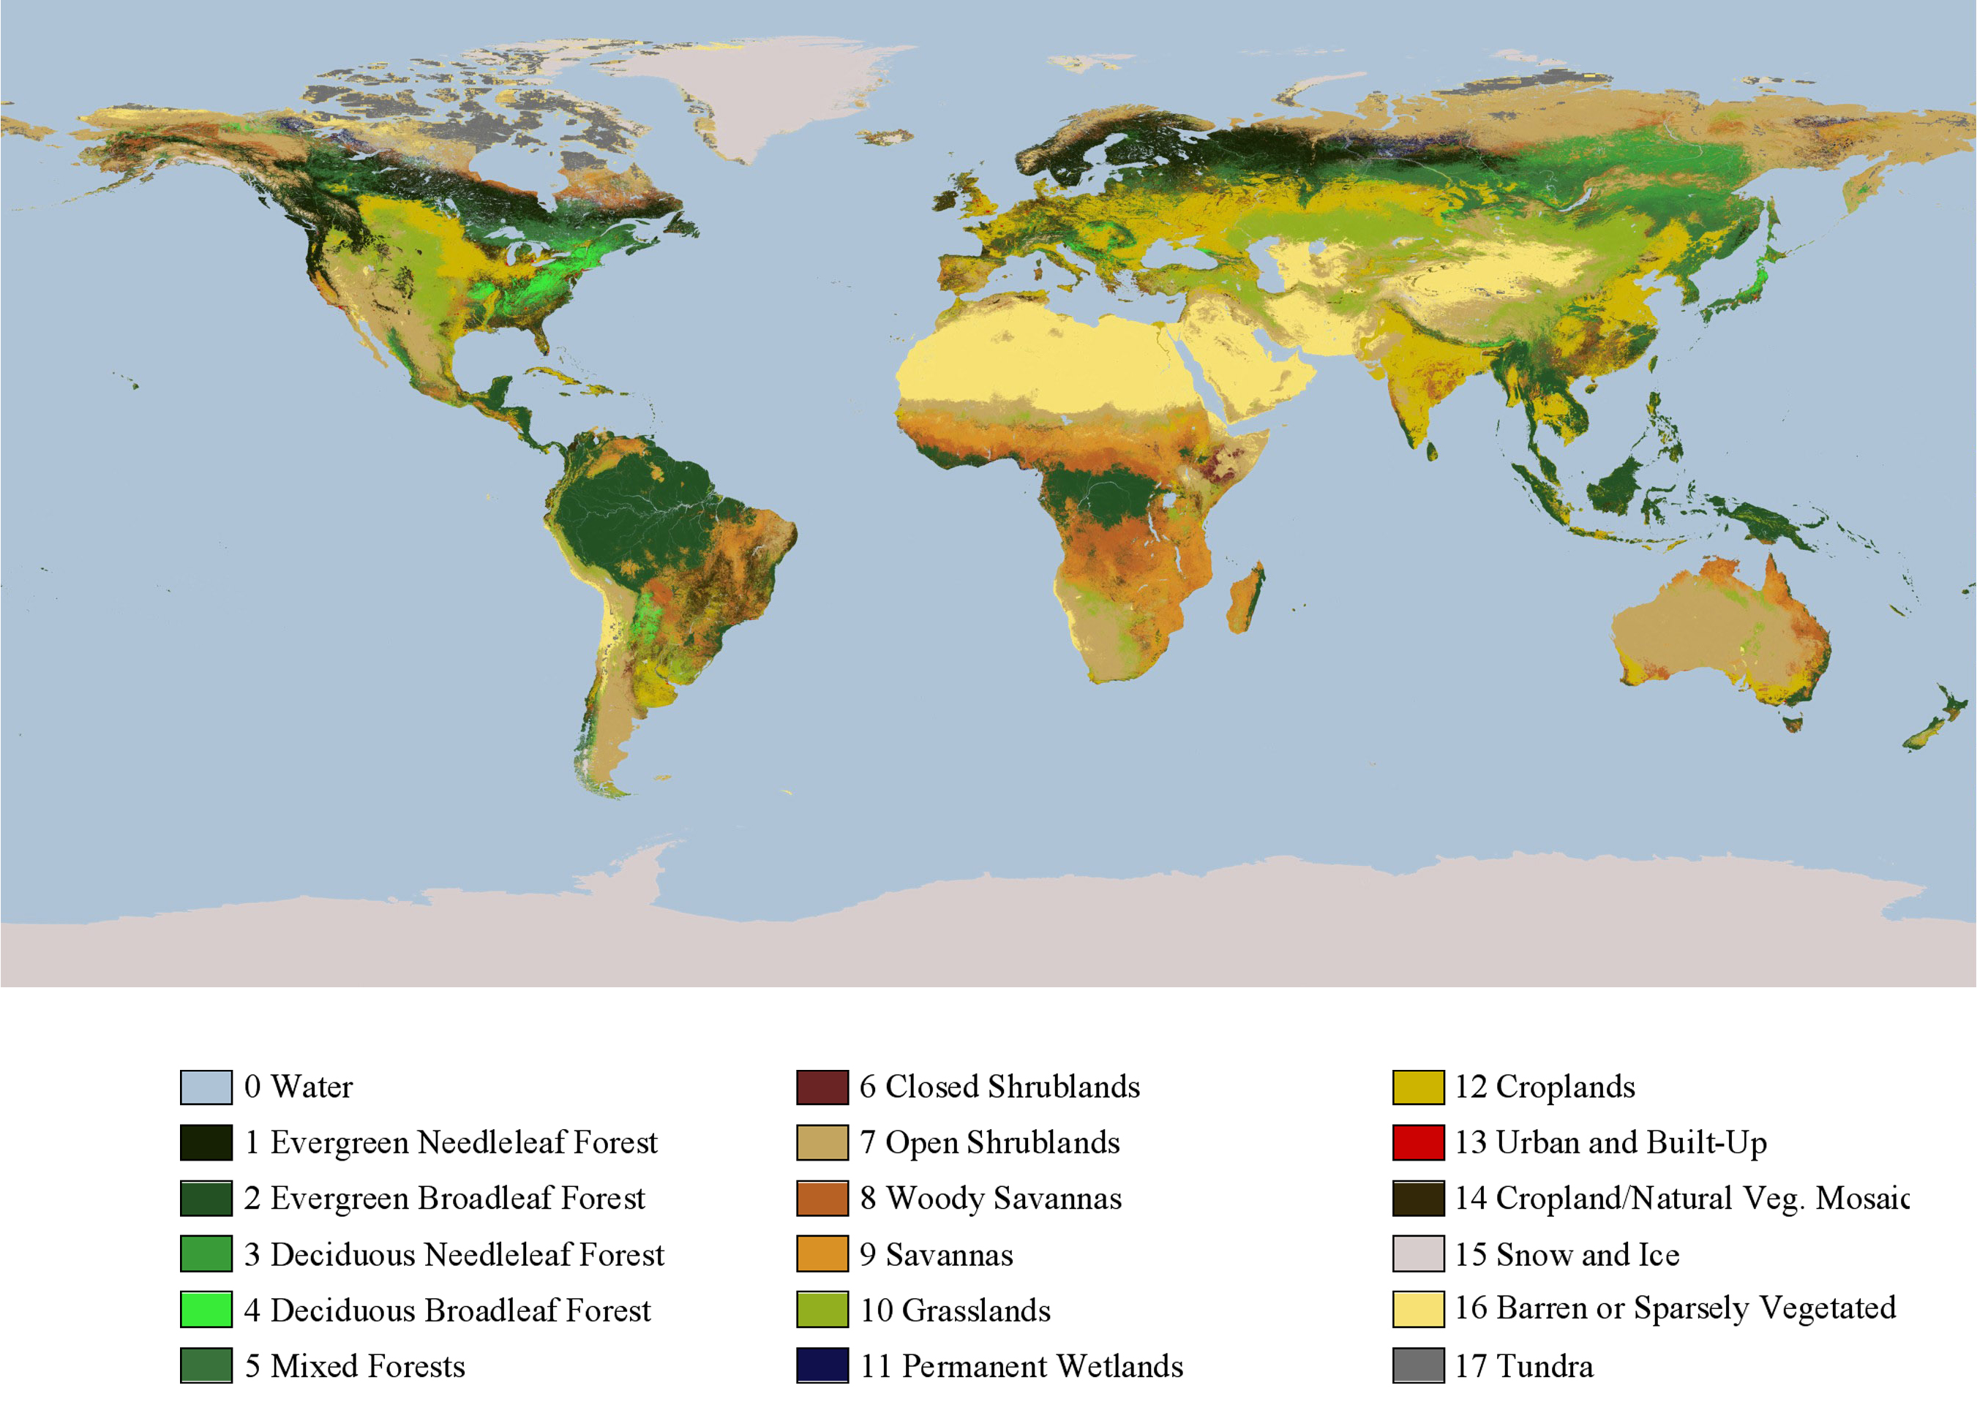
Land cover/ Land use change

Slide 16
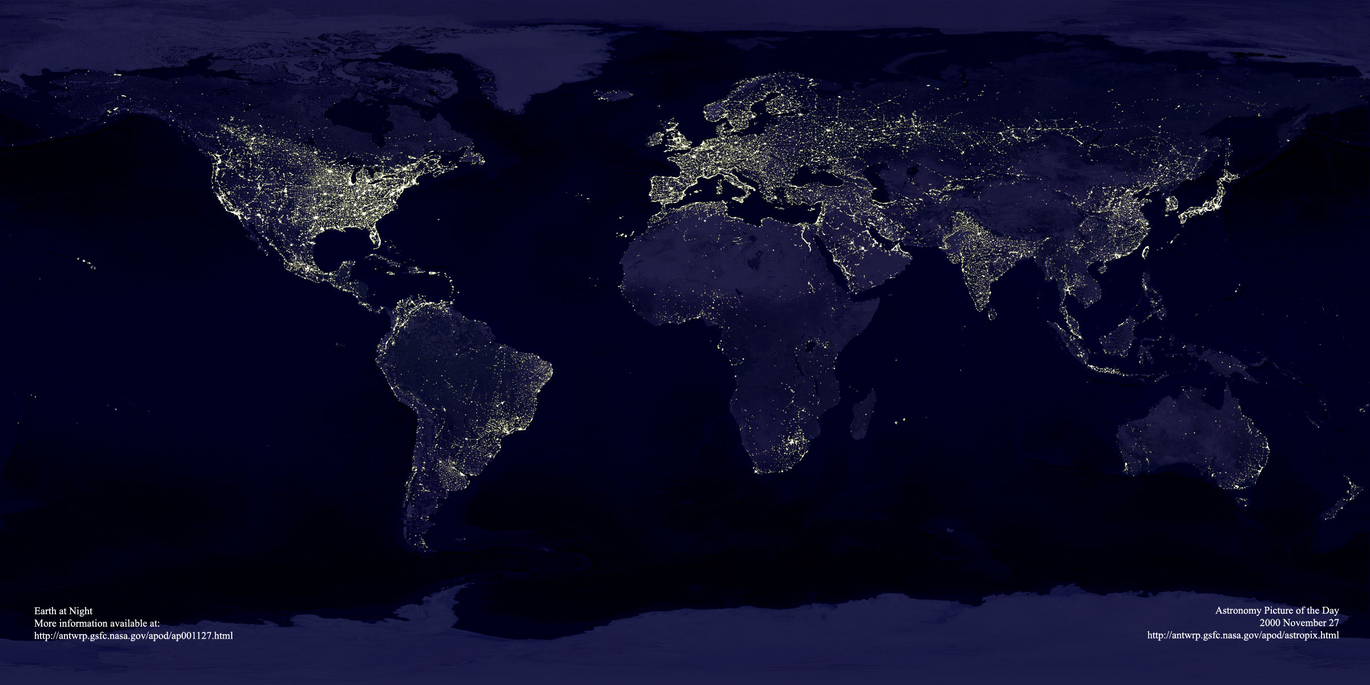
Population Mapping
Notes:
Satellites can still detect important information at night. For example, urban areas show population centers.
Wildfires can also be detected.

Slide 17
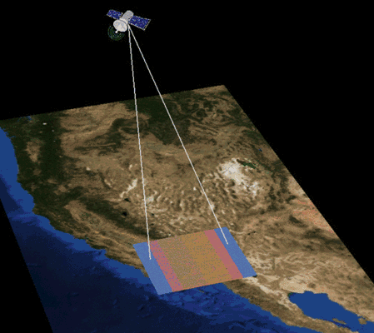
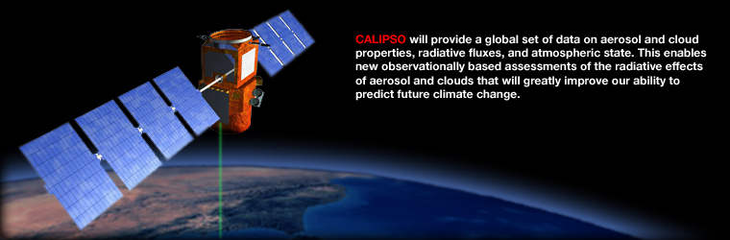
Air quality
Multi-Angle Imager for Aerosols (MAIA)
Scheduled to launch in 2022
MAPS
Measures distribution of CO 3-10km above the earth’s surface
Near global CO database
TOMS
Measures ozone, UV, aerosols, and volcanic ash emissions
Landsat 7 and Calipso
Air Pollution Monitoring
Ozone, CO, Sulfur Dioxide, Nitrogen Dioxide
Measure proportion of light blocked by particulate matter for atmospheric modeling
Notes:
Several sensors are specifically designed to measure the dynamics of atmospheric column
CO in the lower atmosphere is measured by NASA’s MAPS instrument
Providse a global database of atmospheric CO levels to measure how pollutants travel from sources, size, etc.
NASA’s Earth Probe Satellites TOMS instrument measures ozone UV, aerosols, volcanic ash emissions (sulfur dioxide)

Slide 18
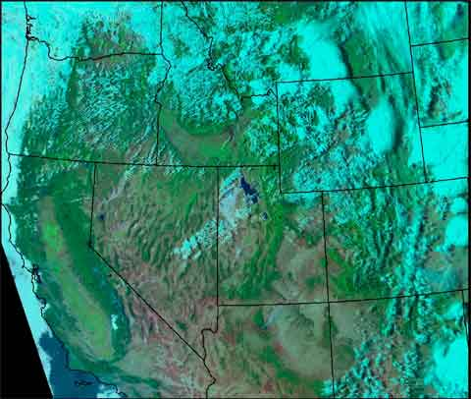
Weather and Climate Modeling
Instantaneous data on local, regional conditions
Longer-term climatological summaries
Changes in mean, variance
source: U.S. Forest Service
Notes:
Weather and climate are the principal drivers of ecological patterns and processes
Remote sensing has dramatically increased availability of climate data, especially for geographic regions in which ground-based weather stations are few and widely dispersed
Selection of climatic data for ecological models should be based on the target response variable and the purpose of the model
Plants and animals with short generation times, and the probability of phenomena such as fire or flood, often are sensitive to short-term fluctuations in temperature and precipitation
Species with longer generation times, and longer-term changes in land cover, may be more closely associated with climate patterns over time
In some cases, changes in the variance in temperature, precipitation and weather events may be more influential than long-term averages

Slide 19
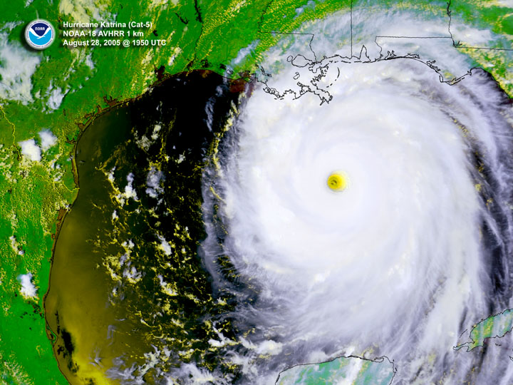
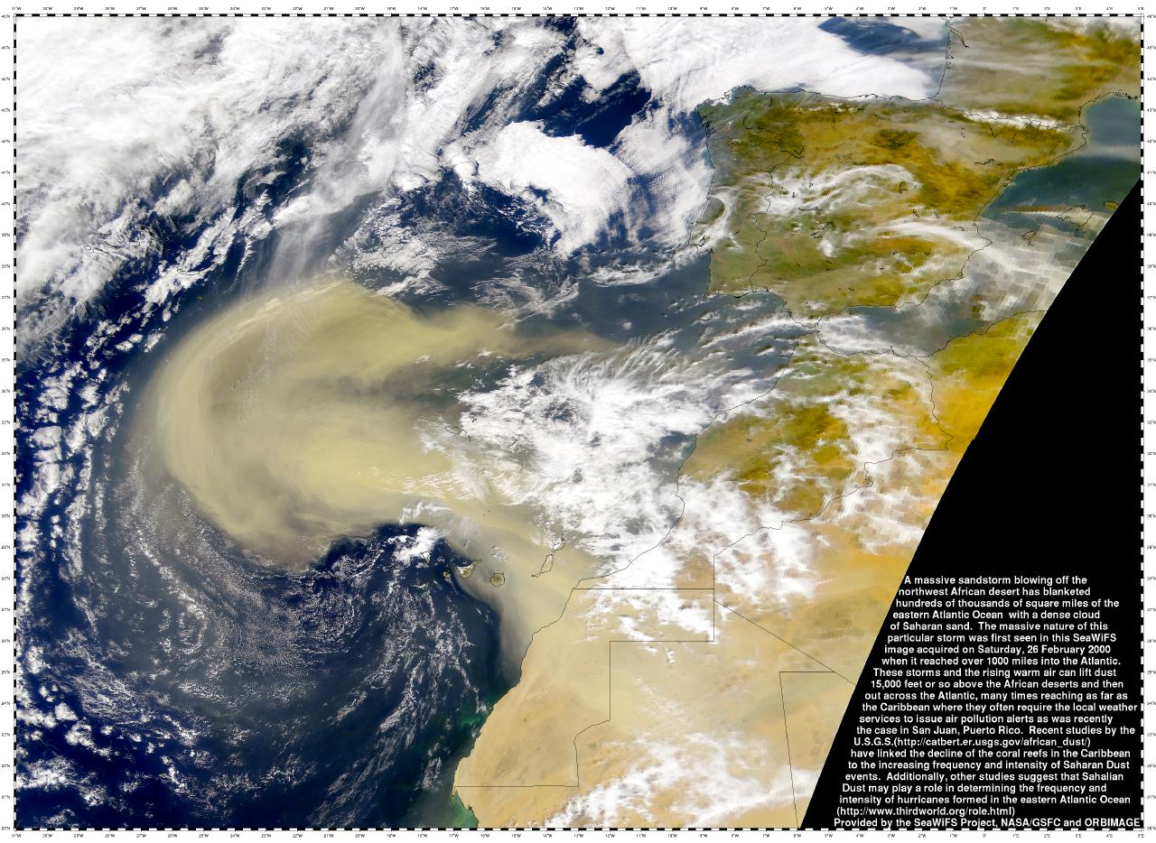
Disaster Monitoring and Response
Hurricane Katrina
African Dust storm
Source: NOAA
Source: NASA

Slide 20
Aquatic Ecosystems
Runoff
Flooding
Water quality
Water body extent
River flow rates
Wetlands mapping
Water surface elevation and depth
Ocean color
Coral reef mapping
Benthic habitat
Oil spill monitoring
Cooley, S., Jenkins, A., Schaeffer, B., Abdallah, A., Granger, S., & Friedl, L. (in review). Research to Operations: Pathways to Success for Research-Driven Decision-Making. Journal of Technology Transfer.
Notes:
Remote sensing is used to map and monitor a number of different features in ovean and inland water ecosystems
Some of the items listed on this slide are addressed in the following slides

Slide 21
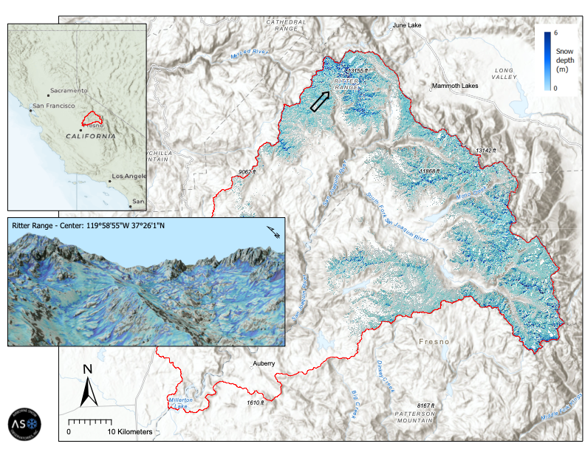
Hydrology
Hydrologic Modeling:
Watershed geometry
Drainage network
Empirical Equations
Annual runoff, Flood peak, Low flow
Runoff Modeling:
Land use
Soil moisture
Topography
Water Quality:
Suspended sediments
Estimate chlorophyll
Temperature
Turbidity
Eutrophication
Spatially-distributed snow depth observations collected on May 4-5, 2020 by the Airborne Snow Observatory (ASO) are shown for the San Joaquin River Basin, CA. ASO measured the entire snowpack within the 4,500 km² watershed area and provided snow depth products at a spatial resolution of 3 x 3 m and snow water equivalent (SWE) products at 50 x 50 m spatial resolution (not shown) within 72 hours of the survey.
Cooley, S., Jenkins, A., Schaeffer, B., Abdallah, A., Granger, S., & Friedl, L. (in review). Research to Operations: Pathways to Success for Research-Driven Decision-Making. Journal of Technology Transfer.
Notes:
- Remote sensing can be used for determining watershed geometry and drainage network for hydrologic models and for empirical flood peak, annual runoff or low flow equations
Sensors also provide input data such as land use, soil moisture, and topography for runoff modeling. Remote Sensing techniques can be used to assess several water quality parameters largely because of the curvilinear relationship between suspended sediments and sensor reflectance
Eutrophication of a water body (when high concentration of nutrients in a water body stimulates the bloom of algae; though part of the natural aging process, exacerbated by humans and considered “pollution”) is usually quantified in terms of the concentration of the chlorophyll contained in the algae/plankton
Thermal discharge into streams, lakes and coastal waters from electrical power plants has been mapped with remotely sensed data (Gibbons et al., 1989).

Slide 22
Advantages of RS
Cost-effective method of monitoring land cover and use
Allow monitoring of global processes
Can observe remote areas
Enable the integration of many different types of data
Encourage better information management
Facilitate historical comparisons
Create a clear and striking visual product
Develop and compare options for future land use
Notes:
Remote sensing has given us a new perspective of the earth’s processes and land use patterns. It provides a cost-effective tool to monitor changes in land cover and use. It also is one of the only ways to monitor large-scale and global processes. Remote sensing can allow us to observe remote or difficult to access areas
In combination with GIS, it allows us to integrate information in new ways and provides us with an increased understanding of the processes that link ecosystems together. With GIS, physical, biological, and socio-economic information can be combined to give a complete picture of a region. Linking different data in one system, encourages better information management and also facilitates historical comparisons by standardizing data.
A GIS analysis prodices a clear, cisual image of conservation and land use needs that can be easily understoon by decision-makers and communities. In turn, this facilitates decision-making.
Finally, GIS can be used to consider different options and model different land uses. This can ensure better land use planning in the future.

Slide 23
Limitations of RS
Cost of satellite images, software and equipment
Cloud cover
Error in data interpretation
Satellite coverage
Lack of visible light
Large data storage needs
Limited historical data
Lack of good species data
Notes:
While RS and GIS can be excellent research tools, there are a number of limitations to their use:
One major problem is the cost of satellite images and equipment. To reduce costs, several organizations can purchase images jointly.
The cost of images is compounded by the need to buy many images in areas where cloud cover is high. This can be a particular problem, for areas, for example, like Vietnam, where areas of humid forest tend to have thick cloud cover. Unlike aerial photos, you can not pick ideal conditions (except in rare cases and for lots of money) for the satellite pass over an area. This problem can be offset by using radar images, which can penetrate cloud cover; however, these images are harder to interpret and there is limited historical data.
Because a satellite image covers a particular grid, if your study site overlaps more than one image, costs will increase dramarically.
In some areas of the world, satellite coverage (that is, the number of satellites that actually pass over a particular place, can be a problem). Generally, this is not an issue in Vietnam. Because RS and GIS create large files, large data storage capacity is needed.
Historical comparisons are limited since satellite images have only been available since 1972. For GIS applications, the lack of adequate species is a constraint. Data can be also misinterpreted especially if vegetation is not spectrally unique. For example, in the images of Chicago during a dry year, wetlands emittefd the same spectral wavelength or signature as grasslands.

